Slide 1
Utility Legal Issues Update
Alaska Power Association
2020 Annual Meeting
Andy Leman
Kemppel, Huffman & Ellis, P.C.
Notes:
Thank you, this is the Utility Legal Issues Update.
Nothing in this presentation should be considered to be legal advice or recommendations. If it were legal advice, I’d send you a bill.
Before taking any actions based on anything you hear today, you ought to talk to your lawyer about any of the issues we discuss today, even if I’m your lawyer.

Slide 2
Topics
The War is Over: The Animals Won
Governance
Only You Can Prevent Forest Fires
The Budding Marijuana Problem in Alaska
Legal or Illegal?
Notes:
Trying to keep this a little shorter this year; it is difficult because there is just nothing sweeter to a lawyer than the sound of his own voice; but it is a little easier now that we are offering our management legal workshop every year, where we have more time to talk about topics

Slide 3
The War is Over: The Animals Won
Last Christmas travel season, the Philadelphia airport Popeye’s location began packing to-go orders in these “Emotional Support Chicken” boxes

Slide 4
The War is Over: The Animals Won
Just an emotional support alligator visiting a Pennsylvania assisted living facility in January 2019. . .
Notes:
“He’s never bitten anyone and is afraid of cats.”

Slide 5
The War is Over: The Animals Won
New sign at the Alaska State Fair in 2018
Delta Airlines being sued by a woman who was bitten by an emotional support dog in 2019
Ongoing litigation in Chicago over Guinea Hog
Notes:
Mayle suffers from bipolar disorder. Because Mayle is allergic to dogs, he depends on his Guinea Hog, Chief Wiggum, to provide service and emotional support. The Guinea Hog performs tasks such as massage therapy on Mayle’s hands to mitigate feelings of anxiety and depression. The Guinea Hog also encourages Mayle to engage in physical activity: Mayle transports the Guinea Hog with a shopping cart attached to his bike. Finally, Mayle is a Satanist and uses his Guinea Hog during his religious practices.
Mayle v. Chicago Park Dist., No. 18 C 6211, 2019 WL 2773681, at *1 (N.D. Ill. July 2, 2019)
Court agreed that the hog was not a service animal, but City of Chicago still had obligation to consider accommodating hog under Title II of ADA (broader than Title III applicable to non-government)

Slide 6
The War is Over: The Animals Won
EEOC sues over refusal to accommodate and retaliation against commercial truck driver who wanted emotional support dog to accompany him
Psychiatrist prescribed an emotional support animal
Case allowed to proceed

Slide 7
The War is Over: The Animals Won
New Alaska Human Rights Act regulations for service animals:
Employers must treat a request from a qualified employee to use an animal to assist him or her in the performance of the essential functions of the job as a request for a reasonable accommodation and engage in an interactive process to determine whether or not the accommodation is reasonable
Notes:
6 AAC 30.610(o)
-does not limit reasonable accommodation to service or alert animal, so it could include emotional support animals
-could be interpreted to mean that you have to grant the accommodation requested, even if other accommodations the employer would prefer are available

Slide 8
Cooperative Governance: Defamation
Cooperative member began questioning management and operations decisions
Included loaning money to GM, hiring GM’s son to succeed him and not retiring capital credits
After meeting with cooperative, member bought 9 newspaper ads to publicize his concerns
Member formed “Take Back Our Cooperative” and sued Cooperative, GM, son, officers and directors
Settled with resignation of GM and formation of committee to evaluate issues and advise Board
Notes:
Occasionally get questions about suing for defamation when someone is unhappy with things a director or member has said. Defamation means suing because someone has said something harmful. It is an excellent tool for sending needy children of attorneys to college.
Rosser v. Clyatt, Nos. A18A0843, A18A0987, 2018 Ga. App. LEXIS 633, 2018 WL 5729226 (Ga. Ct. App. Nov. 2, 2018).

Slide 9
Cooperative Governance: Defamation
Five months later GM sued member for defamation
Member said his statements were based on:
Cooperative employees working on GM’s personal vehicles
GM storing his personal vehicles at Cooperative
GM not paying late fees on a loan owed to Cooperative
Statements from unnamed sources regarding a tree-trimming company and other kickbacks
Subsidiary transactions uncovered by an attorney’s research
Cooperative’s failure to provide requested documents

Slide 10
Cooperative Governance: Defamation
Court found that GM was “limited public figure” for purposes of issues related to the cooperative
Must prove “actual malice” to prevail – that the member knew what he said was false or did so with reckless disregard for the truth – very high standard
Comments like GM “stole” or engaged in “fraud” were not used in legal sense
Many of the statements were essentially opinions about which many people could reasonably differ
Notes:
Take away: absent exceptional circumstances, defamation litigation is not going to help when someone attacks the cooperative or its employees

Slide 11
Cooperative Governance: South Carolina
Member sues Tri-County Electric in South Carolina, claiming it paid its Board more than any cooperative in South Carolina
$6 million over 14 years for per diem, health insurance and other benefits
$52,000 each in 2016, where state average was $28,000 and national average was $15,000
Health insurance and large number of meetings were cost drivers – held 50 meetings, many were extra and as brief as 15 minutes – Board members got $450 each meeting
Notes:
The State, May 23, 2018, updated May 24, 2018 – Customer sues Midlands utility that paid its board ‘enormous and undeserved profits’
Cooperative’s attorney said “you’ve got people who are relatively uneducated. They’re country people. . .”
BTW, new Board and new Bylaws at this cooperative now – Board expenses down 30%

Slide 12
Cooperative Governance: Virginia
Members of Virginia’s largest cooperative filed petition to force vote on series of Bylaw proposals
Working with Solar United Neighbors of Virginia
Bylaws would
Allow members to attend Board meetings
Require posting of video of Board meetings
Annual disclosure of Board compensation
New rules for proxy voting
Board members receive $2,000 per month retainer fee and $500 per diem for meetings
2016 ranged from $13,500 to $48,950 for directors
Notes:
Blocked by-law proposals at Virginia’s largest electric cooperative prompt complaint to state regulators
July 27, 2018 – Richmond Time Dispatch

Slide 13
Cooperative Governance: Louisiana
Louisiana Public Service Commission (LPSC) ordered investigation of all 10 electric cooperatives in the state
Some Board members make as much as $50,000 per year
Most received health, vision and life insurance
Noted one Board where members received $250 per day for meeting fees
In March 2019, LPSC ordered all cooperatives to report compensation to their members and hold membership vote on compensation
Also imposed term limits
Notes:
Baton Rouge Advocate, Sept. 19, 2018 – Eye-popping pay, perks at Louisiana electric co-ops sparks investigation
Baton Rouge Advocate, March 20, 2019– State regulator approve restrictions on compensation for coop directors

Slide 14
Cooperative Governance: Arizona and Kentucky
Arizona Public Service Commission
IBEW objected to Cooperative rate increase
$19,146 per Board member for insurance plus $27,000 for one meeting per month; average of $46,256 per director
Kentucky Public Service Commission ordered audit of Cooperative that agreed to pay full lifetime health insurance costs for utility’s former outside attorney and his wife
Did the same for the union’s attorney and union employees
Audit will include role of Board
Notes:
The Independent, February 15, 2019 – Proposed hike in meter rate raises questions about cooperative’s spending
Journal-Times, Mar 28, 2019 – Public Service Commission orders audit of Grayson Rural Electric

Slide 15
Cooperative Governance
Is Alaska at risk?
Alaska has open meeting and member access to record requirements that many other states do not
Alaska cooperatives generally have open and fair election procedures
Director health insurance has gone from being common to almost nonexistent
To the extent being driven by opposition to coal generation, less of a risk for Alaska
But Alaska also has significantly higher travel costs than the Lower 48

Slide 16
Cooperative Governance
What can you do?
Boards should engage in periodic self-evaluation and part of that evaluation should include Board compensation and cost of governance
Be careful and conservative with use of executive sessions
Retire capital credits
Take advantage of training opportunities
Learn from the experiences of other cooperatives that have had governance issues
Notes:
You can do comparisons with Form 990

Slide 17
Only You Can Prevent Forest Fires
Just in the last few days we’ve seen a disaster declared in the Mat-Su after high winds caused trees to contact power lines
KTVA reported last night that MEA had to shutdown power to several miles of the Parks Highway – 80 structures lost
Butte County District Attorney considering manslaughter charges against PG&E for the 2018 Camp Fire
California Attorney General has said murder charges could be filed if PG&E in failing to keep lines and poles free of hazardous vegetation during times of fire danger, acted with a “conscious disregard for life.”
Notes:
Very important birthday earlier this month – who turned 75?
”Only you [as in YOU-tilities] can prevent forest fires” is what the plaintiffs’ lawyers want

Slide 18
Only You Can Prevent Forest Fires
What can a utility do if a tree outside of its easement could contact a line?
Does it matter if the tree is diseased or dying?
Alaska has treble damages for unauthorized tree cutting
How can a utility insure for all property damage caused by a tree contacting a line?
Notes:
We can’t be global warming insurance for the state
Failing to establish reasonable rules for easement/fire claims will drive rates higher
Does it really make sense to have a utility insure your home against fire damage?

Slide 19
Only You Can Prevent Forest Fires
APA working on legislation to limit utility liability
Protect utilities from liability for trees outside easement
Limit liability for trees inside easement to cases where utility did not follow its own written vegetation management plan
Requires state as landowner to incorporate these standards into permits/leases/easements
Review vegetation management records management
Review contracting, purchasing and conflicts policies for compliance with FEMA standards
Notes:
Alaska utilities need protection from factors beyond their control and need to know what standard they will be held to for the things they can control

Slide 20
The Budding Marijuana Problem in Alaska
Pretty “mellow” year for marijuana
While Gov. Dunleavy has appointed less marijuana friendly Board members, it has not shown any signs of slowing down the green tidal wave
Alaska has adopted on-site consumption rules
With local opt out
Canada has legalized recreational marijuana nationwide
Michigan, Missouri and Utah all expanded access; Illinois will be fully legal starting in 2020
Notes:
Michigan is full recreational, Missouri is medical (est. up to 200,000 qualify), Utah is medical; Illinois will be full recreational

Slide 21
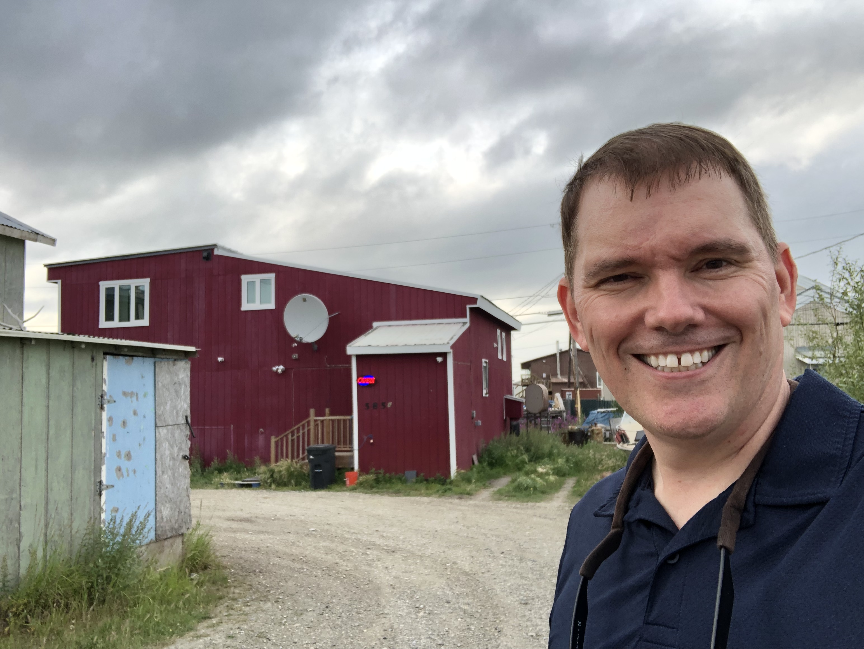
The Budding Marijuana Problem in Alaska
In addition to the Railbelt marijuana retail is:
Active in Dillingham, Haines, Juneau, Ketchikan, Kodiak, Kotzebue, Nome, Petersburg, Sitka, Skagway and Valdez
Likely coming soon to Bethel, Cordova, Craig, and Utqiagvik
Notes:
Me in front of the northernmost cannabis store – maybe in the world – Kotzebue.

Slide 22
The Budding Marijuana Problem in Alaska
Credit Union 1 in Anchorage made headlines last year for announcing a pilot program to provide financial services to marijuana businesses
Will end August 30
Insurance broker told CU1 that their liability insurance would not be renewed because of the marijuana pilot program
Bloomberg reported earlier this year that beverage makers are racing to make drinkable marijuana
Could create THC drinks that are water soluble like alcohol and thus absorbed much more quickly
A federally-funded study in Washington confirmed that based on analysis of sewage, marijuana consumption doubled over three years after legalization
Notes:
KTUU website 6-21-19

Slide 23
The Budding Marijuana Problem in Alaska
Other states continue to advance protective measures for marijuana users in employment
Illinois, Nevada the latest
ASPCA reported in 2019 that emergency pet marijuana overdose calls are up 765% over the past ten years
Notes:
Illinois law will prohibit firing an employee unless they are “impaired” which is defined as “specific, articulable symptoms while working that decrease or less the employee’s performance”
-shifts the paradigm from “you look impaired, let’s test to confirm,” to let’s confirm by seeing if you are impaired
Nevada law prohibits refusing to hire for pre-employment marijuana test
No action in Alaska to protect employees, but starting to see employers look at “don’t ask, don’t tell” marijuana testing policies for employees where testing is not federally-mandated

Slide 24
The Budding Marijuana Problem in Alaska
Are you complying with federal law for cash payments?
31 CFR § 1010.330 says:
Any business or trade
Receives $10,000 in cash in a single transaction or 2 or more related transactions within a year of each other
A utility bill paid in cash of $833.34 per month will hit $10,000
Notes:
I do not expect anyone to come after utilities for failing to report cash transactions that exceed $10,000, but I didn’t expect that I’d hear we cancelled a meeting with Denmark because they wouldn’t sell us Greenland

Slide 25
Legal or Illegal?
Employee stalked by customer for over a year, with talking and touching, resulting in “no contact” order from state court
Costco eventually revoked his membership after extensive stalking incidents
Employee took unpaid medical leave
Terminated when she did not return to work, based on company policy (no leave beyond 12 months);
Employee wanted an additional 1-2 years
Legal or illegal?
Notes:
EEOC v. Costco Wholesale Corp.
903 F.3d 618 (7th Cir. Sept. 10, 2018)
Not legal, will be up to jury to decide whether it was illegal.
EEOC legal theories – company tolerated sexual harassment and constructive discharge;
Court said “Severe or pervasive” not a mathematically precise formula and no requirement for overtly sexual conduct – fear of safety
No back pay during leave of absence unless EEOC could show she was forced to take leave; back pay would be “for some period of time following the involuntary leave” and further subject to mitigation and sent back to trial court

Slide 26
Legal or Illegal?
Employee began work as warehouse clerk
Was rapidly promoted six times over the next two years to assistant ops manager
Employee learned that male subordinate was spreading rumors in warehouse that Employee had slept with a higher-ranking manager
Highest ranking manager at the facility became aware of the rumors but did not stop them; he even helped spread the rumors

Slide 27
Legal or Illegal?
Employee experienced open resentment and disrespect from co-workers and those she supervised
Overall manager yelled at employee, told her the rumors would prevent future promotions and engaged in other hostile behavior
Employee complained to HR manager about the overall manager and her subordinate who started the rumors

Slide 28
Legal or Illegal?
Subordinate filed his own claim that Employee was creating hostile work environment for him
Employee given two warnings – for subordinate’s complaint and for insubordination towards overall manager
Employee sued under Title VII
Employer convinced district court that hostile work environment was not due to gender but false allegations about Employee’s conduct
Legal or illegal?
Notes:
Illegal.
4th Circuit said that sex-based nature of the rumor; similar to sex stereotypes being sex discrimination; court was particularly interested in the fact that the overall manager participated in the rumors and was directly responsible for some of the worst harassment she experienced
Parker v. Reema Consulting Services, 915 F.3d 297 (4th Cir. 2019)

Slide 29
Legal or Illegal?
Cooperative hires employee as HR Generalist in HR department
Employee was pregnant at time of hire and employer knew she planed to take maternity leave
Employer provided 12 weeks of maternity under FMLA even though she did not qualify
Towards the end of her 12 weeks, she submitted documentation showing she had severe postpartum depression and separation anxiety

Slide 30
Legal or Illegal?
Employee asked for additional leave time
Employer granted additional leave and a reduced work schedule when she returned to work
Employee provided additional documentation stating she would need to work part-time for the “foreseeable future” and likely for at least 2-6 months
Employee returned to work for about two months before she was terminated

Slide 31
Legal or Illegal?
Employee claimed she handled all of her duties
Employer claimed she did not finish some critical job functions and HR Department was understaffed because of her reduced work hours
Employee responded that problem was more severe because of another employee’s leave of absence and department was working on a time intensive benefits project
Employer said that the position was full time
Termination legal or illegal?

Slide 32
Legal or Illegal?
Trial court granted summary judgment to employer
Said that being able to work 40 hours per week was an essential function of the position
Sixth Circuit Court of Appeals reversed
Noted that in this case, employer rescinded an already granted accommodation
So did not apply the usual ADA burden shifting approach
Whether she could complete the essential functions of her job on a part-time schedule was a question of fact for the jury
Notes:
Trial court said legal, but court of appeals said illegal.
Hostettler v. College of Wooster, 2018 WL 3432244 (6th Cir. July 17, 2018)

Slide 33
Legal or Illegal?
Court distinguished a prior case where it had held that “regular, in-person attendance is an essential function of most jobs.”
Said that whether a job function is truly essential is “highly fact specific,” and court must look at time spent on the function, employer's judgment, job description and consequences for not performing the function
Court relied on employee affidavit that she completed her “core” job functions and corroborating affidavit from fellow employee
Also relied on positive performance review during her part-time work that was positive and did not mention work schedule

Slide 34
Legal or Illegal?
Take aways:
Full-time presence is not an essential function in a vacuum, it has to be tied to other critical job requirements
An employer cannot deny part-time schedule as a per se unreasonable accommodation
Once you grant an accommodation, it becomes much more difficult to argue that it is unreasonable to grant it again or extend its duration
Even more true if the past accommodations were not tied to a disability claim but were allowed for some other reason
If you have pets in the office every Friday, hard to say an emotional support animal is an unreasonable accomodation

Slide 35
Legal or Illegal?
Employee with hip and back issues requested eight hour day as accommodation of disability under state and federal law
Worked as delivery driver where overtime was common
Employer said working overtime was essential function of the position
Unpredictable conditions, holidays, etc. can cause drivers to need more than 8 hours to finish a route
Legal or illegal to deny him the accommodation of an 8 hour limit?
Notes:
Legal
Faidley v. UPS of America, Inc., 889 F.3d 933 (8th Cir. 2018)
Court said that ability to work overtime was essential function – noted that CBA, job description and consequences of failing to perform the function all pointed in this direction
-can see how this logic could apply to a lineman doing summer construction or winter storm response

Slide 36
Legal or Illegal?
Employee offered position as electronic technician subject to undergoing physical exam
Medical examine found met physical qualifications but referred him to company’s chief medical officer because he weighted 256 pounds at a height of 5’6” – severely or morbidly obese
Company withdraws offer
Legal or illegal?
Notes:
Illegal in Washington, probably not illegal under ADA. Alaska?
Taylor v. Burlington N. R.R. Holdings, 904 F.3d 846 (9th Cir. 2018) and 444 P.3d 606 (Wash. 2019)
EEOC regulations says “obesity constitutes an impairment under the ADA under some but not all circumstances” – must be the result of a physiological disorder 29 CFR § 1630.2(h)
Found qualifies as disability under state law
How would this work with a power plant operator or lineman?

Slide 37
Want to Learn More?
For more, plan on attending the May 2020 APA Management Legal Workshop
Employment Issues
FEMA Compliance Before Disaster Strikes
Regulatory
And more!
Board training on:
Director responsibilities
Governance issues – NRECA Governance Task Force
Conflicts of Interest
Open Meetings
Notes:
NRECA training is great, but what we offer is training that is specific to Alaska law and to your cooperative’s Bylaws and Policies; we also give directors the opportunity to discuss these issues as a Board that they do not always get at NRECA or NWPPA training

Slide 38
The End

